Slide 1
ECE 471/571 – Lecture 22
Syntactic Pattern Recognition
11/21/14

Slide 2
Recap
Pattern Classification
Statistical Approach
Non-Statistical Approach
Supervised
Unsupervised
Decision-tree
Basic concepts:
Baysian decision rule
(MPP, LR, Discri.)
Basic concepts:
Distance
Agglomerative method
Syntactic approach
Parameter estimate (ML, BL)
k-means
Non-Parametric learning (kNN)
Winner-take-all
LDF (Perceptron)
Kohonen maps
NN (BP, Hopfield, DL)
Support Vector Machine
Dimensionality
Reduction
FLD, PCA
Performance Evaluation
ROC curve (TP, TN, FN, FP)
cross validation
Stochastic Methods
local opt (GD, EM)
global opt (SA, GA)
Classifier Fusion
majority voting
NB, BKS

Slide 3
Key Concept
If we can draw it (automatically), then we can recognize it
Based on formal language

Slide 4
Philosophy
A grammar generates a (possibly infinite) set of strings (pictures)
If we can design a grammar which generates a class of strings, then we can build a machine which will recognize any string in that class

Slide 5
Types of Grammars - Symbols
V_{N}: the set of non-terminal symbols
V_{T}: the set of terminal symbols
P: the set of rewriting rules (productions)
S: the start symbol
: the empty (null) symbol

Slide 6
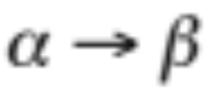
Type 0 Grammar
No restrictions on rewriting rules
The string α (whenever it occurs in a deviation) may be replaced by the string β

Slide 7
Type 1 – Context Sensitive

Slide 8
Type 2 – Context Free
Left side must be a single non-terminal
Example
A → α
S → 0S1
S → 01

Slide 9
Type 3 - Regular
A → aB, or A → a
A and B are single non-terminal
Is a regular grammar also context-free?

Slide 10
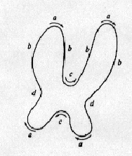
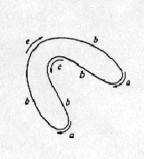

Example
Describe two types of chromosomes for recognition (submedian chromosome and telocentric chromosome)
Chromosome is represented as a string, obtained by tracing the outline in clockwise direction
Pattern primitives = terminal symbols

Slide 11
Example (cont’)
Grammar for recognition of submedian and telocentric chromosomes
  G = (V_{N}, V_{T}, P, S)
Non-terminals
  V_{N} = {S, S₁*, S₂*, A, B, C, D, E, F}
  S – start symbol
  S₁* – submedian chromosome
  S₂* – telocentric chromosome
  A – armpair, B – bottom, C – side, D – arm, E – rightpart, F - leftpart

Slide 12
Example (cont’)
Production (rewriting rules)
S → S₁* B → e S → S2* C → bC
S₁* → AA C → Cb S₂* → BA C → b
A → CA C → d A → AC D → bD
A → DE D → Db A → FD D → a
B → bD E → cD B → Bb F → Dc

Slide 13
Example (cont’)
babcbabdacad
ebabcbab
S → S₁* → AA → ACA → FDCA → DcDCA →
bDcDCA → bDbcDCA → babcDCA →
babcbDCA → babcbDbCA → babcbabCA →
babcbabdA → babcbabdAC → babcbabdDEC →
babcbabdaEC → babcbabdacDC →
babcbabdacaC → babcbabdacad

Slide 14
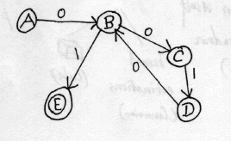
Finite State Machine
A regular expression determines a finite-state machine
  0(010)*1
  S → A, A → 0B, B → 0C, C → 1D, D → 0B, B → 1

Slide 15
Recognition of Abnormal ECG
Regular grammar
  G = ({S, A, B, C, D, E, H}, {p, r, t, b}, P, S)
Productions:
  S → pA, A → rB, B→ bC, C → tD, D → b, D → bE, E → b, E → bH, E → pA, H → b, H → bS, H → pA
r
p
t
b
b b b

Slide 16
ECG (cont’)
Example of derivation of a well formed ECG wave:
  S → pA → prB → prbC → prbtD → prbtbE → prbtbbH → prbtbbbS → prbtbbbpA → prbtbbbprB → prbtbbbprbC → prbtbbbprbtD → prbtbbbprbtbE → prbtbbbprbtbb → … etc.
Note possibility of variable number of “b’s”
  One to three to accommodate normal variations of heart rate

Slide 17
The FSM
r
b
t
A
B
C
D
p
b
b
p
S
p
b
b
E
b
b
H
FSM

